Slide 1
9. Limit Theorems

Slide 2
Many times we do not need to calculate probabilities exactly
An approximate or qualitative estimate often suffices
P(magnitude 7+ earthquake within 10 years) = ?

Slide 3
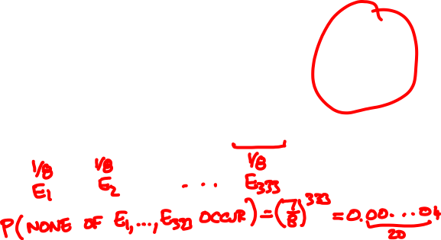

I toss a coin 1000 times. The probability that I get a streak of 3 consecutive heads is
A
B
C
< 10%
≈ 50%
> 90%

Slide 4
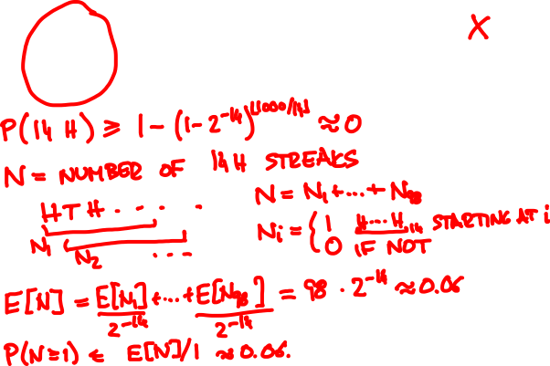
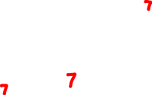
I toss a coin 1000 times. The probability that I get a streak of 14 consecutive heads is
A
B
C
< 10%
≈ 50%
> 90%

Slide 5
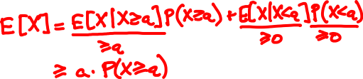
Markov’s inequality
For every non-negative random variable X and every value a:
P(X ≥ a) ≤ E[X] / a.
Proof

Slide 6
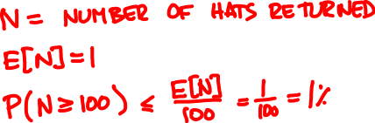
1000 people throw their hats in the air. What is the probability at least 100 people get their hat back?

Slide 7
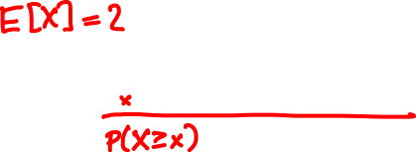

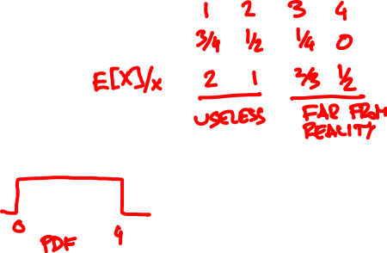
X = Uniform(0, 4). How does P(X ≥ x) compare with Markov’s inequality?

Slide 8
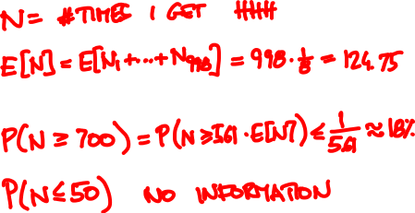
I toss a coin 1000 times. What is the probability I get 3 consecutive heads
(a) at least 700 times
(b) at most 50 times

Slide 9
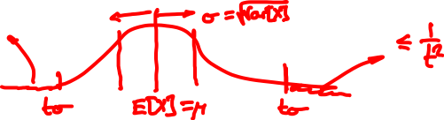
Chebyshev’s inequality
For every random variable X and every t:
P(|X – μ| ≥ tσ) ≤ 1 / t².
where μ = E[X], σ = √Var[X].

Slide 10
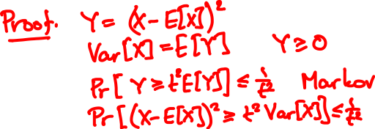
Chebyshev’s inequality
For every random variable X and every t:
P(|X – μ| ≥ tσ) ≤ 1 / t².
where μ = E[X], σ = √Var[X].

Slide 11
μ
a
Markov’s inequality:
P( X ≥ a ) ≤ μ / a.
p.m.f. / p.d.f. of X
0
μ – tσ
μ
μ + tσ
Chebyshev’s inequality:
P(|X – μ| ≥ tσ ) ≤ 1 / t².
σ
p.m.f. / p.d.f. of X

Slide 12

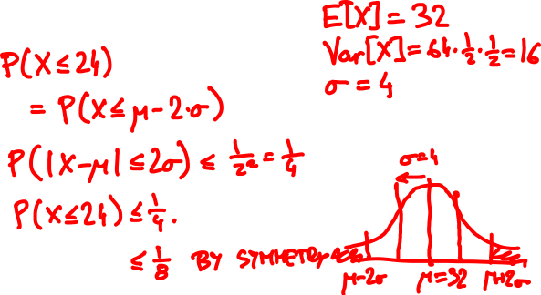
I toss a coin 64 times. What is the probability I get at most 24 heads?

Slide 13
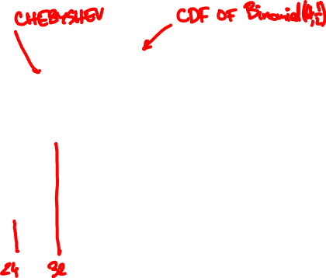

Slide 14
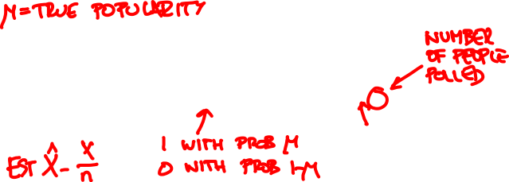
Polling
👩🏻‍🦳👩🏻‍🎤👵🤰🏽🧔🏼👧🏻👨🏻‍🏫🧕👨‍✈️👨🏾‍🎨
👍👍👎👍👎👎👎👎👍👎
X = X₁ + … + X_{n}

Slide 15
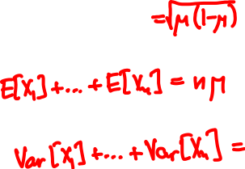

Polling
How accurate is the pollster’s estimate X/n?
μ = E[X_{i}], σ = √Var[X_{i}]
E[X] =
Var[X] =

Slide 16
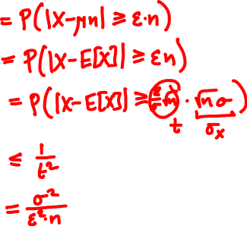

Polling
P( |X/n – μ| ≥ ε )

Slide 17

The weak law of large numbers
X₁,…, X_{n} are independent with same PMF/PDF
μ = E[X_{i}], σ = √Var[X_{i}],
X = X₁ + … + X_{n}
For every ε, δ > 0 and n ≥ σ²/(ε²δ):
P(|X/n – μ| ≥ ε) ≤ δ

Slide 18

We want confidence error δ = 10% and sampling error ε = 5% . How many people should we poll?

Slide 19
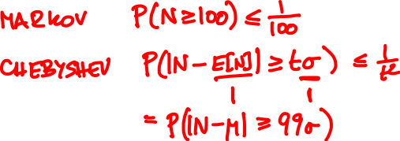

1000 people throw their hats in the air. What is the probability at least 100 people get their hat back?

Slide 20
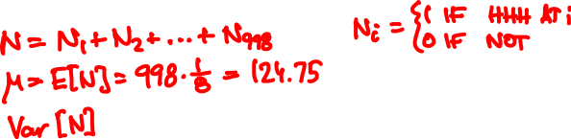
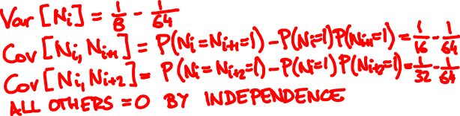

I toss a coin 1000 times. What is the probability I get 3 consecutive heads
(a) at least 250 times
(b) at most 50 times

Slide 21
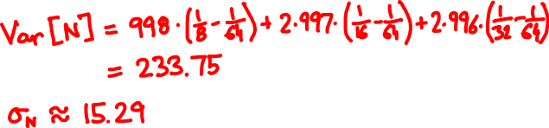
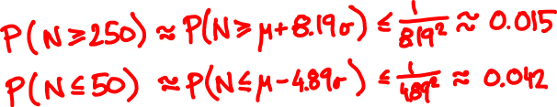

Slide 22

A polling simulation
X₁, …, X_{n} independent Bernoulli(1/2)
X₁ + … + X_{n}
n
pollster’s estimate
number of people polled n

Slide 23
A polling simulation
20 simulations
X₁ + … + X_{n}
n
pollster’s estimate
number of people polled n

Slide 24

X₁,…, X_{n} are independent with same PMF/PDF
Let’s assume n is large.
Weak law of large numbers:
X₁ + … + X_{n} ≈ μn
with high probability
P( |X – μn| ≥ tσ √n ) ≤ 1 / t².
this suggests X₁ + … + X_{n} ≈ μn + Tσ √n

Slide 25

Some experiments
X = X₁ + … + X_{n}
X_{i} independent Bernoulli(1/2)
n = 6
n = 40

Slide 26

X = X₁ + … + X_{n}
X_{i} independent Poisson(1)
n = 3
n = 20

Slide 27

X = X₁ + … + X_{n}
X_{i} independent Uniform(0, 1)
n = 2
n = 10

Slide 28

f(t) = (2π)^{-½} e^{-t /2}
²
t

Slide 29
The central limit theorem
X₁,…, X_{n} are independent with same PMF/PDF
μ = E[X_{i}], σ = √Var[X_{i}], X = X₁ + … + X_{n}
For every t (positive or negative):
lim P(X ≤ μn + tσ √n ) = P(N ≤ t)
n → ∞
where N is a normal random variable.

Slide 30
eventually, everything
is normal

Slide 31
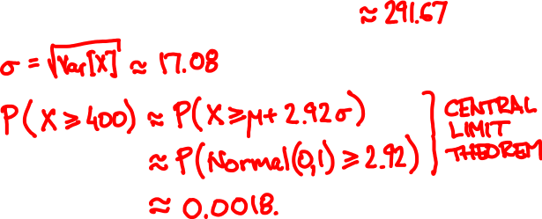
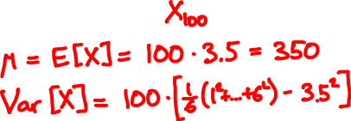
Toss a die 100 times. What is the probability that the sum of the outcomes exceeds 400?

Slide 32

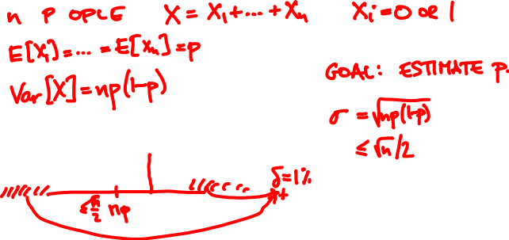

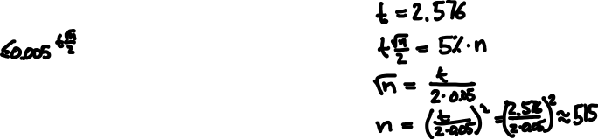
We want confidence error δ = 1% and sampling error ε = 5%. How many people should we poll?

Slide 33
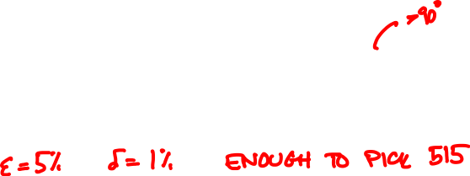
Drop three points at random on a square. What is the probability that they form an acute triangle?

Slide 34
method
requirements
weakness
Markov’s
inequality
one-sided,
often imprecise
E[X] only
Chebyshev’s
inequality
E[X] and Var[X]
often imprecise
weak law of
large numbers
pairwise
independence
often imprecise
central limit
theorem
independence
of many samples
no rigorous bound

Slide 35
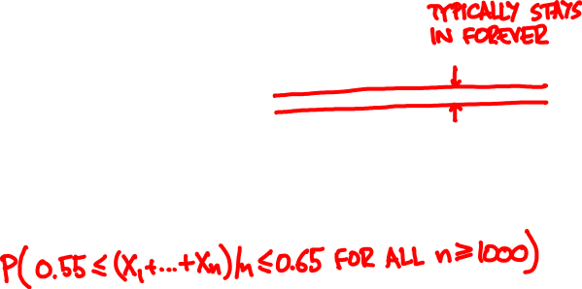
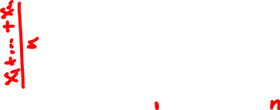
The strong law of large numbers

Slide 36
The strong law of large numbers
X₁,…, X_{n} are independent with same PMF / PDF
μ = E[X_{i}], X = X₁ + … + X_{n}
If E[X_{i}⁴] is finite then
P(lim_{n → ∞} X/n = μ) = 1

